Slide 1

Employee Data Analysis using Excel
STUDENT NAME: S. SRI HARINI
REGISTER NO: 312216415
DEPARTMENT: B.Com Computer
Application
COLLEGE: SHRI SHANKARLAL SUNDARBAI SHASUN JAIN COLLEGE FOR WOMEN

Slide 2



Slide 3
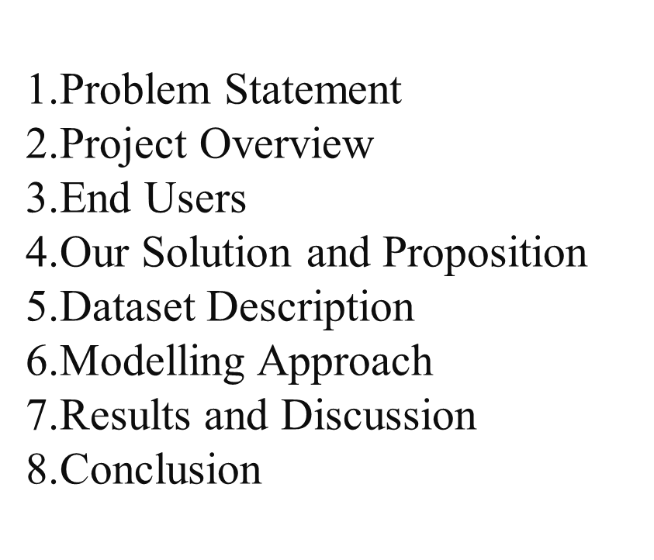
AGENDA

Slide 4

"Despite investing significant time and resources in employee performance evaluations, our organization struggles to effectively assess and improve employee performance, leading to inconsistent productivity, low employee engagement, and limited career development opportunities."
Inefficient Evaluation Process
Inadequate Feedback and Coaching
Limited Career Development Opportunities
Inconsistent Performance Standards:

Slide 5

Project Title: "Employee Performance Analysis and Development (EPAD) System“
Project Objective:
Design and implement a comprehensive employee performance analysis system that streamlines the evaluation process, provides actionable insights, and fosters employee growth and development, ultimately enhancing organizational productivity and competitiveness.
Project Scope:
Develop a standardized performance evaluation framework, including clear performance metrics and benchmarks.
Automate the performance evaluation process, reducing administrative burden and increasing efficiency.

Slide 6

Employees: All employees within the organization, across various departments and levels, will use this employee performance analysis
Managers: Department managers and supervisors will use this employee performance analysis
HR Representatives: Human Resources personnel will use this employee performance analysis
Executive Leadership: Senior executives and leadership team members will use this employee performance analysis

Slide 7

Streamlined Evaluation Process: Automate performance evaluations, reducing administrative burden and increasing efficiency.
Actionable Insights: Provide data-driven insights to inform performance decisions, identify areas for improvement, and optimize employee development.
Personalized Development Plans: Create tailored development plans, aligning employee goals with organizational objectives and career aspirations.
Real-time Feedback and Coaching: Enable managers to provide regular, constructive feedback and coaching, driving employee growth and improvement.

Slide 8

Understanding the Dataset
Data Cleaning and Preparation
Exploratory Data Analysis (EDA)
Advanced Analysis
Reporting and Interpretation
Ethical Considerations
Tools and Techniques

Slide 9


Advanced Predictive Modelling
2. Dynamic Visual Dashboards
3. Comprehensive Performance Segmentation
4. Integrated Data Insights

Slide 10
MODDELLING
Identifying key performance indicators
Analyze relationships between variables
Predict future performance based on historical data
Simulate different scenarios
Identifying areas for improvement
TYPES OF MODELS:
Regression Analysis: Understand relationship between variables
2. Forecasting models: Predict Future Performance
3. Decisions trees: Identify factors influencing performance
4. Simulation models: Test different scenarios
5 Dashboards models: Visualize KPI’s performance metric

Slide 11

GenderCode | (All)
Count of FirstName | Column Labels
Row Labels | Exceeds | Fully Meets | Needs Improvement | PIP | Grand Total
BPC | 12 | 84 | 10 | 2 | 108
CCDR | 15 | 91 | 8 | 2 | 116
EW | 10 | 80 | 4 | 5 | 99
MSC | 13 | 86 | 5 | 2 | 106
NEL | 10 | 83 | 2 | 5 | 100
PL | 12 | 82 | 5 | 6 | 105
PYZ | 11 | 82 | 11 | 4 | 108
SVG | 11 | 79 | 4 | 2 | 96
TNS | 12 | 79 | 7 | 1 | 99
WBL | 14 | 77 | 9 | 1 | 101
Grand Total | 120 | 823 | 65 | 30 | 1038

Slide 13

Employee performance analysis using excel and modelling enables organisations to make data-driven decisions, improve productivity, and drive strategic growth. By leveragig Excel’s powerful tools and modelling techniques, HR professionals and managers can:
Enhance employee development
Optimize performance management
Inform resource allocation
By embracing data-driven insights, organisations can unlock their full potential and achieve success.

